Slide 1


Hello
Project 4 Social Media App
Supervised by Meraki Academic

Slide 2
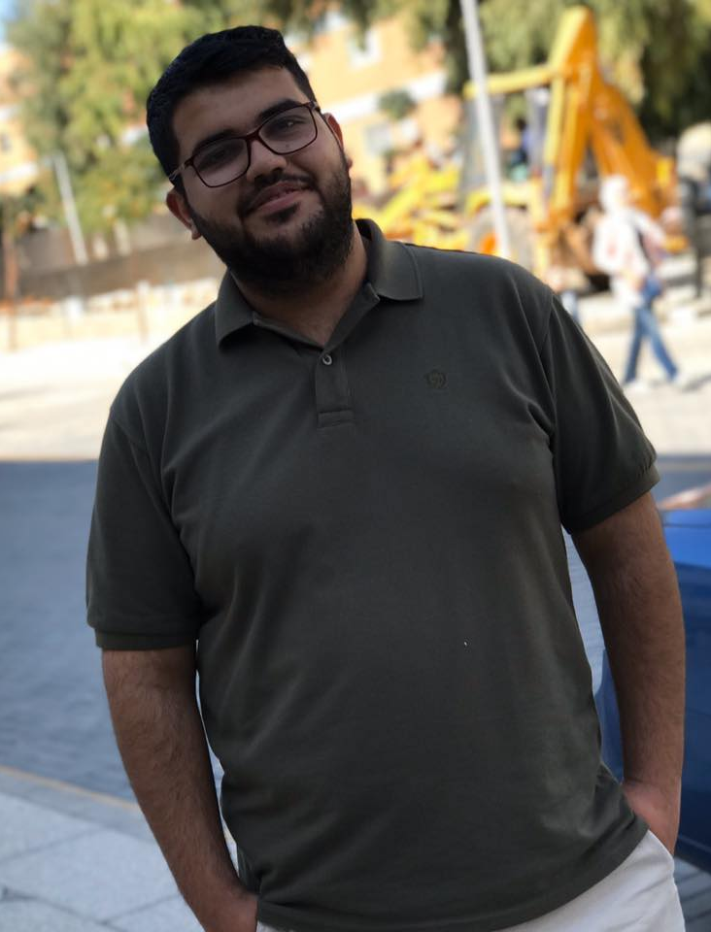
Mohammad AlAbed
Full Stack Web Developer
Mohammad AlAbed
I studied civil engineering and graduated from it, and now I am learning programming because I consider it part of my identity

Slide 3
Contents
01
Describe the project
02
Packages used in the project
04
Tour around the project
03
04
How I applied what I have learned
05
The challenges I faced

Slide 4
Your work is going to fill a large part of your life, and the only way to be truly satisfied is to do what you believe is great work. And the only way to do great work is to love what you do. If you haven't found it yet, keep looking. Don't settle.
My favorite quote
“
“
Your work is going to fill a large part of your life, and the only way to be truly satisfied is to do what you believe is great work. And the only way to do great work is to love what you do. If you haven't found it yet, keep looking. Don't settle.
by Steve Jobs
co-founder of Apple Inc.

Slide 5
Describe the project

Slide 6
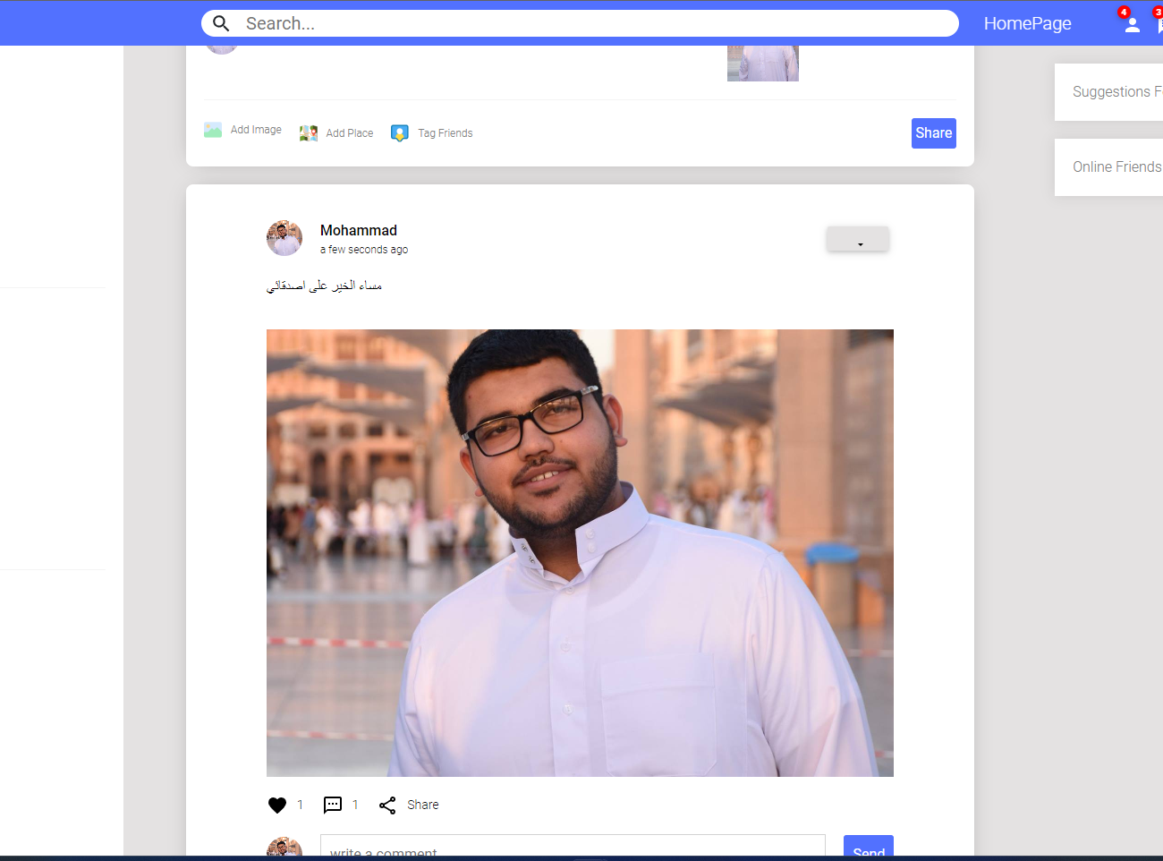
Bow Social
Describe the project
It is a social networking site. for interaction between friends, publishing events and diaries, and getting to know new people
BowSocial.com
You can publish and interact with friends by liking, commenting, and adding friends

Slide 7
The most important packages used in the project

Slide 8
Packages used in the project
Server Side
express
Express.js is a popular web application framework for Node.js. It simplifies the process of building robust and scalable web applications and APIs
mongoose
jsonwebtoken
is an Object Data Modeling (ODM) library for MongoDB and Node.js. It provides an abstraction layer over MongoDB, making it easier to work with MongoDB databases by defining schemas and models for data.
JWTs are used for secure authentication and data exchange between parties in a compact and self-contained way
nodemailer
bcryptjs
is a popular email sending library for Node.js. It simplifies the process of sending emails from your Node.js application, whether it's for sending notifications, confirmation emails,
is a library used for hashing and salting passwords. It's essential for securely storing passwords in databases. a one-way hashing algorithm

Slide 9
Packages used in the project
client side
cloudinary
Cloudinary is a cloud-based image and video management service. It offers features like image and video upload, storage
moment
axios
is a JavaScript library for parsing, formatting, and manipulating dates and times.
Axios is a popular JavaScript library for making HTTP requests from the browser or Node.js. It provides a simple and elegant way to send asynchronous HTTP requests, handle responses,
react-router-dom
bootstrap
is a package commonly used in React applications for handling client-side routing. It allows you to create single-page applications (SPAs) by defining routes and rendering components based on the URL
Bootstrap is a widely used front-end framework for building responsive and visually appealing web interfaces. It includes a collection of CSS and JavaScript components,

Slide 10
Tour around the project

Slide 11
Project stages
Then draw Diagram and WireFrame using mokups
Create databases, use MangoDB, and start experimenting with Postman
Nodejs
React.js
Trillo
Mokups
Date Base
First, we arranged and organized the work using Trillo to identify the stages of the workflow
Server build and Schema build and Controllers
Finally, we used react.js to build user interfaces and send requests to the server

Slide 12
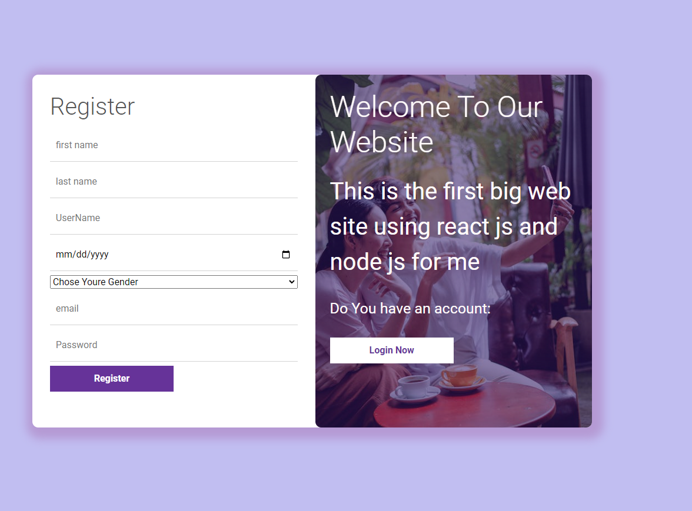
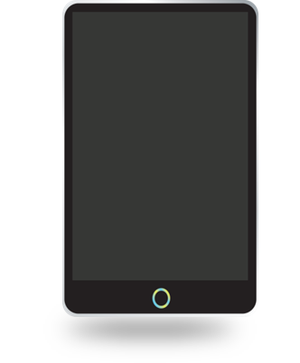
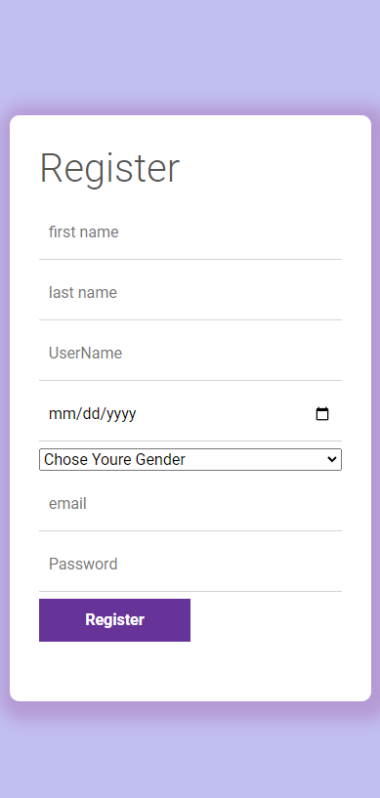
Sign Up Page
To be able to access the site, you must register an account. You can easily register an account by adding some personal data such as name, age, username, email, and password.
It should be noted that the username must be unique, and the email must be real in order for you to receive the activation message.
When you register an account with a unique email, you will receive an activation message on your email

Slide 13
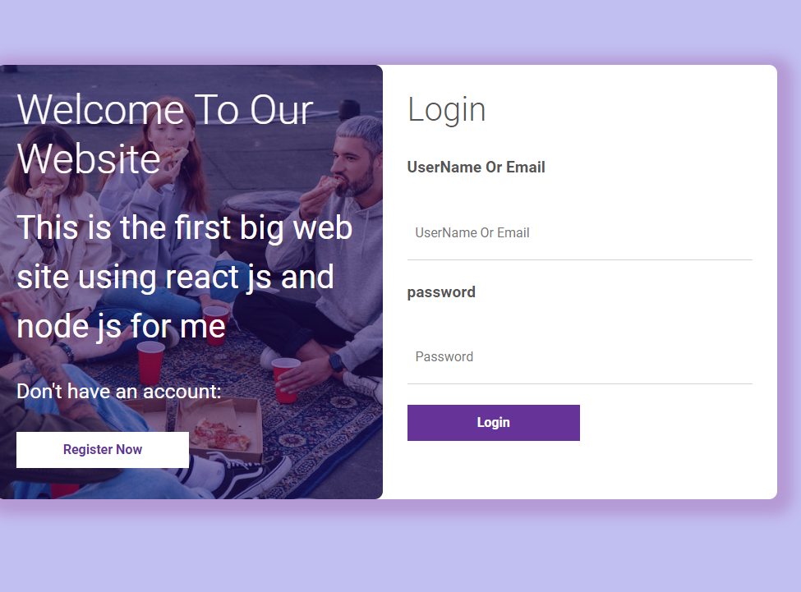
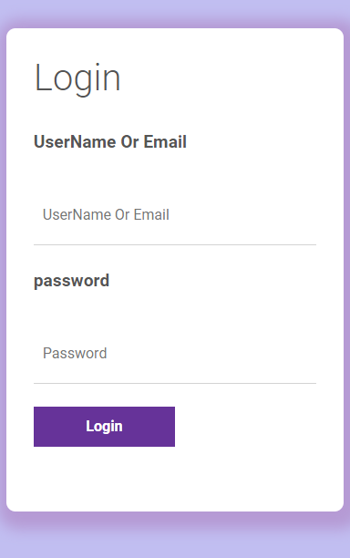
Sign In Page
To be able to access the site, you must Login to your account. You can log in to the site via email or username and password, but you must verify that the email is activated from the confirmation message that arrived.
Now enjoy what you will see

Slide 14
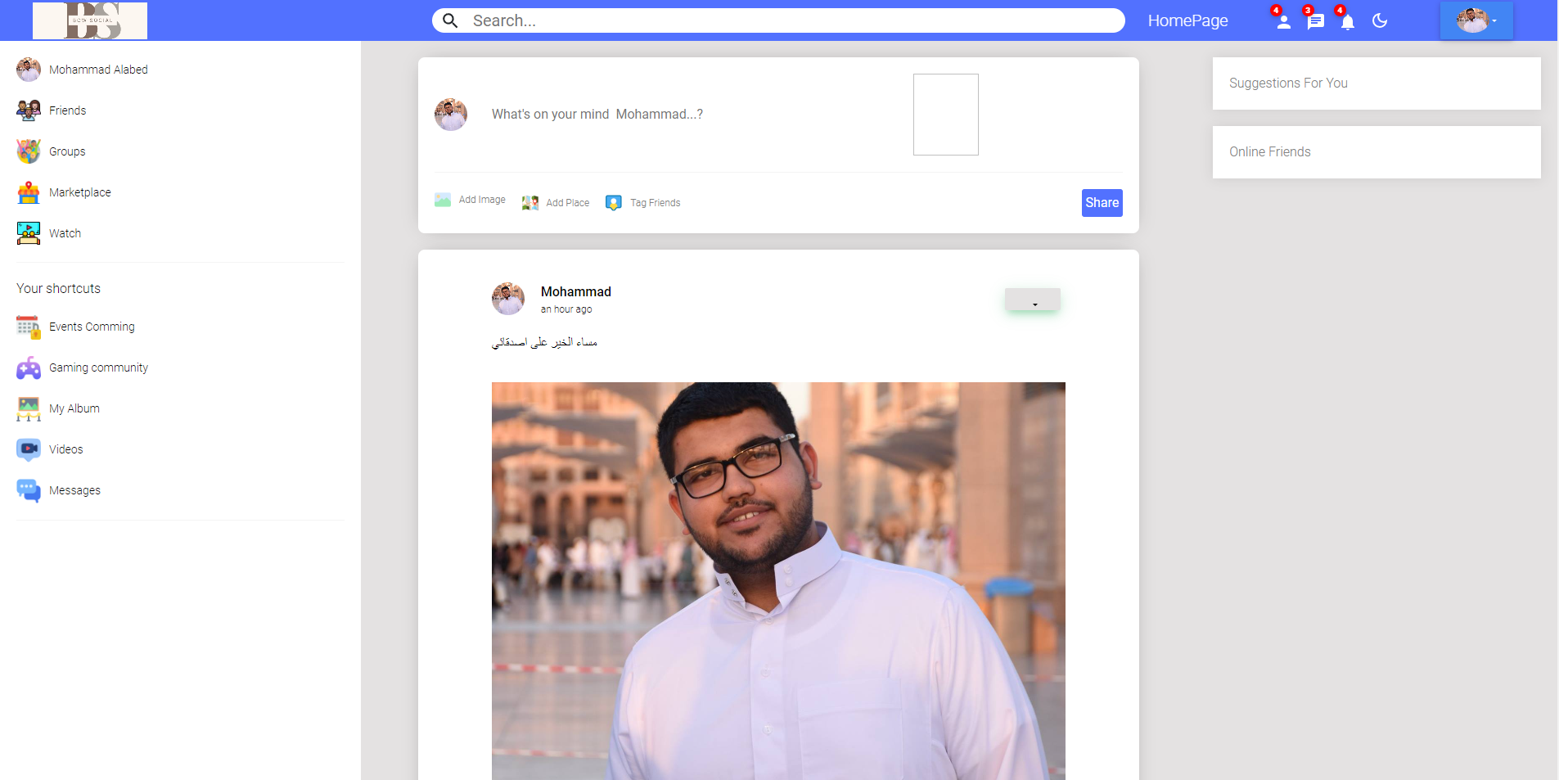
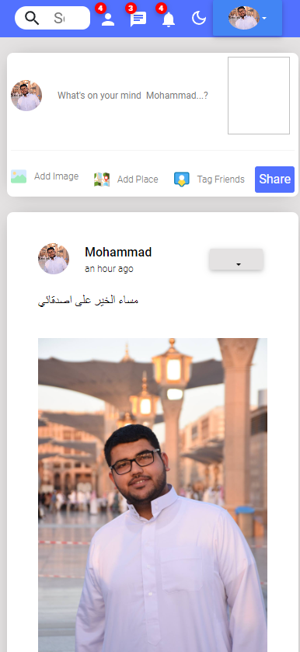
HomePage
This is The Home Page. Here you can publish posts, search for friends, and interact with posts by liking and commenting
Don't forget to like my beautiful posts. 😂😂

Slide 15
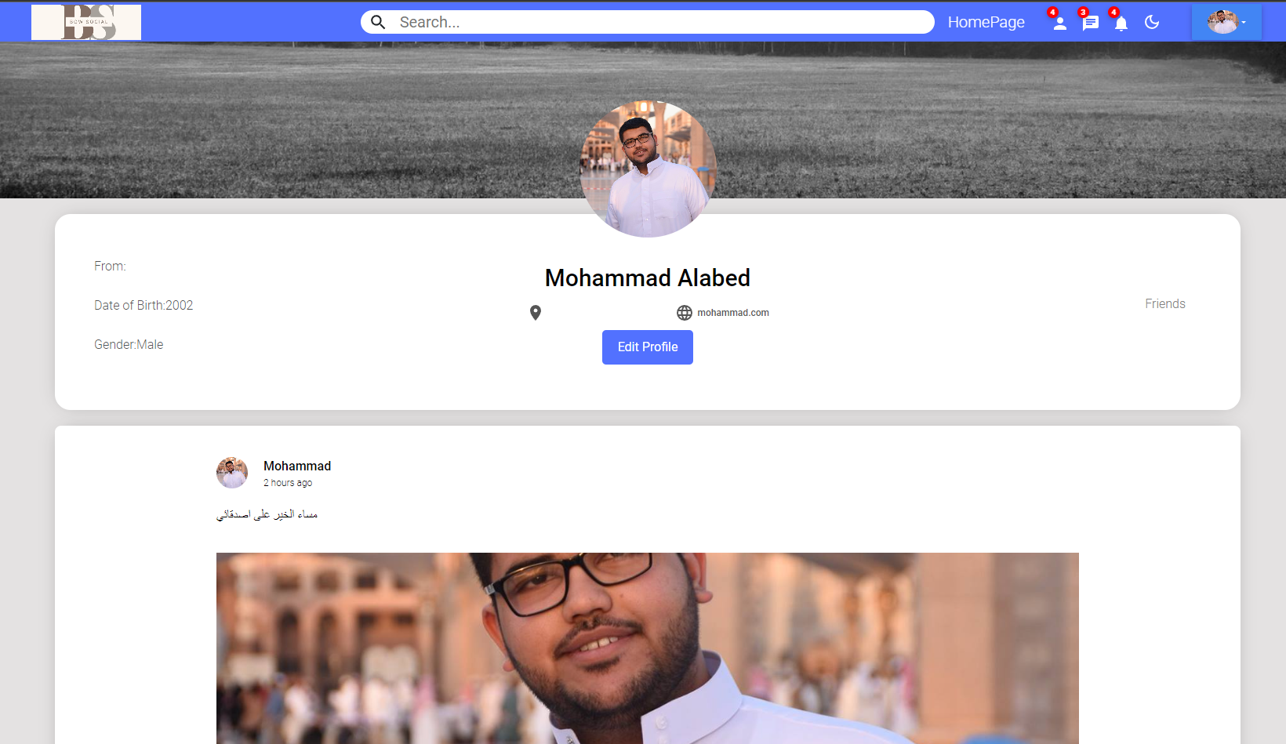
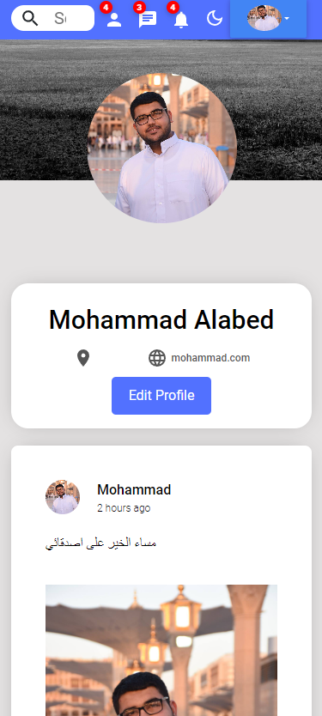
Profile Page
This is The Profile Page. Here you can view your private publications only, modify your personal data via the Edit profile button
Don't forget to like my beautiful posts. 😂😂

Slide 16
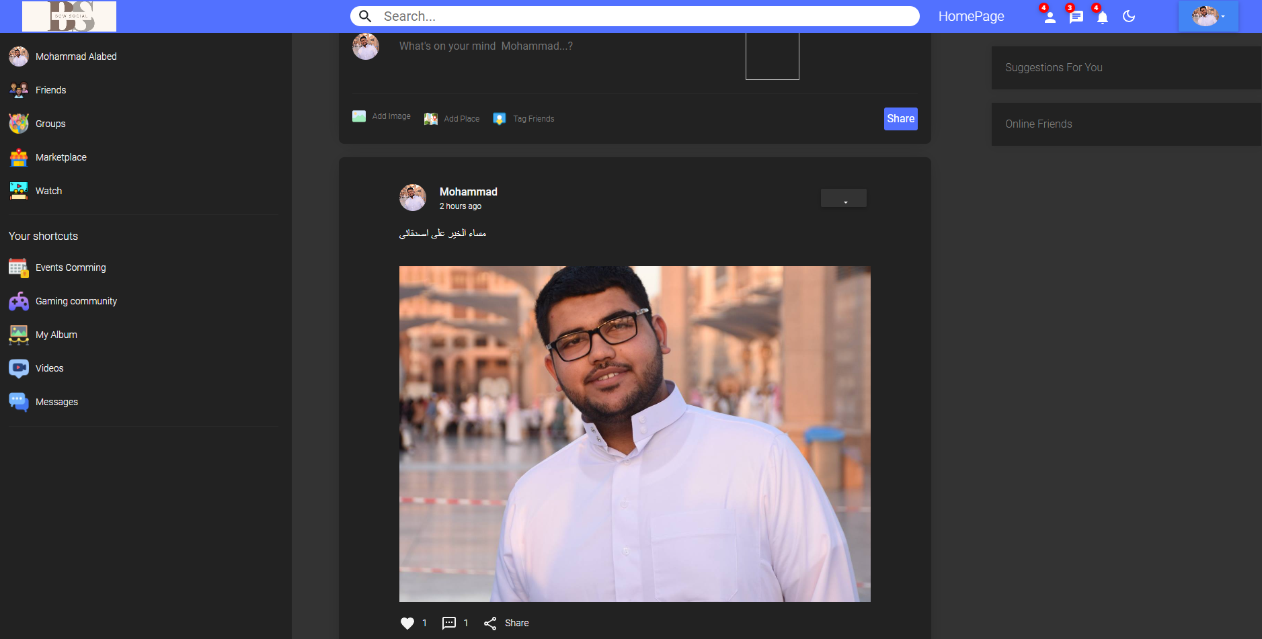
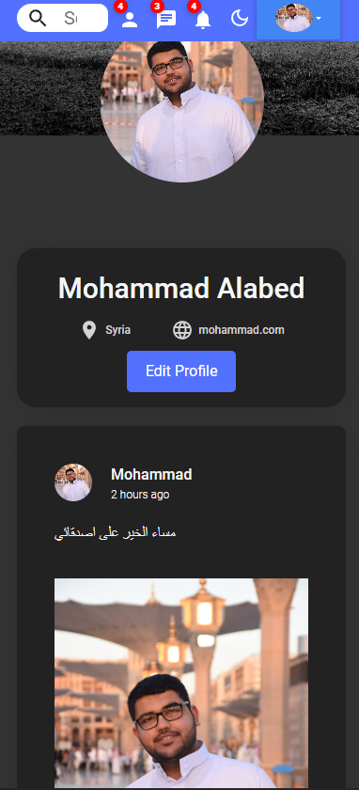
Dark Mood
This is The Dark Mood. For people who like dark mode like me, of course, I did not forget them for all pages.
Have fun with dark mode. 😎😴

Slide 17
How I applied what I have learned

Slide 18
How I applied what I have learned
Use the HOF int the right way
01
This was helping us to display and filter the data using the map and filter
Create a server using nodejs
02
Using the server and databases Dealing with the response and requests using CRUD method
React.js
03
Link between the server side and the client side
CSS
04
Dividing the screen into parts using flexbox and make it responsive to devices of different sizes using Media Query

Slide 19
New things that I have learned

Slide 20
New things that I have learned
nodemailer
01
Use this library to send messages to users via email to activate the account and recover the password
cloudinary
02
Use this database to allow users to upload images to the site
Create theme using scss
03
Creating a theme to facilitate the process of building screens by using this theme on each page, such as the background color or font color
Use template
04
Use the material UI and bootstrap in the right way

Slide 21
The challenges I faced

Slide 22
The challenges I faced
The challenges I faced
nodemailer
01
It was difficult to deal with this library for the first time, but now dealing with it is easy
cloudinary
02
The process of uploading images was difficult. I tried several methods, but in the end, I used this library
Rebuild the Schemes
03
Developing the Schemes several times during the implementation phase of the project

Slide 23
Special thanks

Slide 24
Special thanks
ANAS
ASMA
SAWALMEH
WALA’A
KHALID
CLASS CORDINATER
Jouza
AND ALL THE TEAM

Slide 25
Special thanks to all the people in my life who are supportive and encourage me to continue. I love telling you, thank you.

Slide 26
Thank you

